Slide 1

January 31, 2022 PUBLIC OUTREACH MEETING
Onaga Trail Pedestrian Improvement Project
Town Project No. 7005-2020; ATP No. 5466(025)
and
Little League Drive Pedestrian Improvement Project
Town Project No. 8970-2020; ATP No. 5466(024)

Slide 2
Summary
The 1st Public Outreach Meeting was held on September 16, 2021.
Since then:
Town staff met with numerous property owners to address different issues:
Driveways
Curb and gutter
Mailboxes
Chain link fences
Project Plans are 95% developed

Slide 3
Onaga Trail Pedestrian Improvement Project
Town Project No. 7005-2020
ATP No. 5466(025)

Slide 4
Project Description
Onaga Trail Pedestrian Improvement Project
The project is located on Onaga Trail between Acoma Trail and approximately Grand Avenue.
It is divided in two (2) segments due to existing constraints to meet the General Plan designation. (Arterial – 4 Lane Divided – 100’ ROW)
Both segments would have full width pavement, curb and gutter, handicap ramps, and sidewalk on both sides of Onaga Trail.
This would result in sidewalks on both sides of Onaga Trail, between Sage Avenue and Acoma Trail.

Slide 5
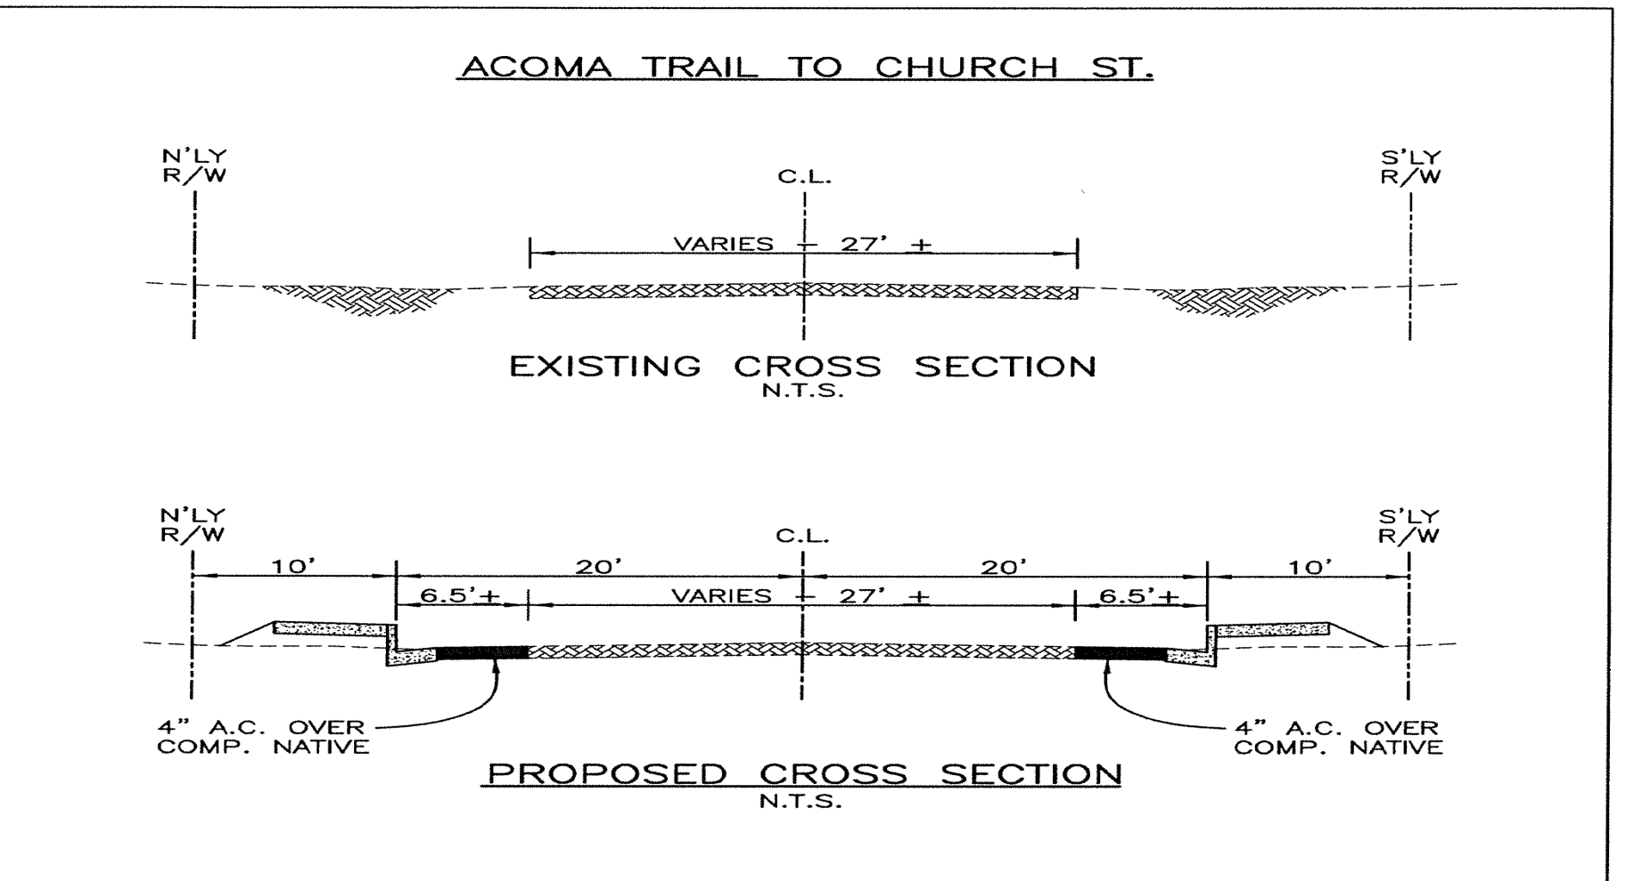
1st Segment - Onaga Street, between Acoma Trail and Church Street
Onaga Trail Pedestrian Improvement Project
Proposed Improvements
Improved to a local road standard of 60 foot right of way.
No additional right of way would be required.
Improvements can be constructed with minimal impact to the existing residences.

Slide 6
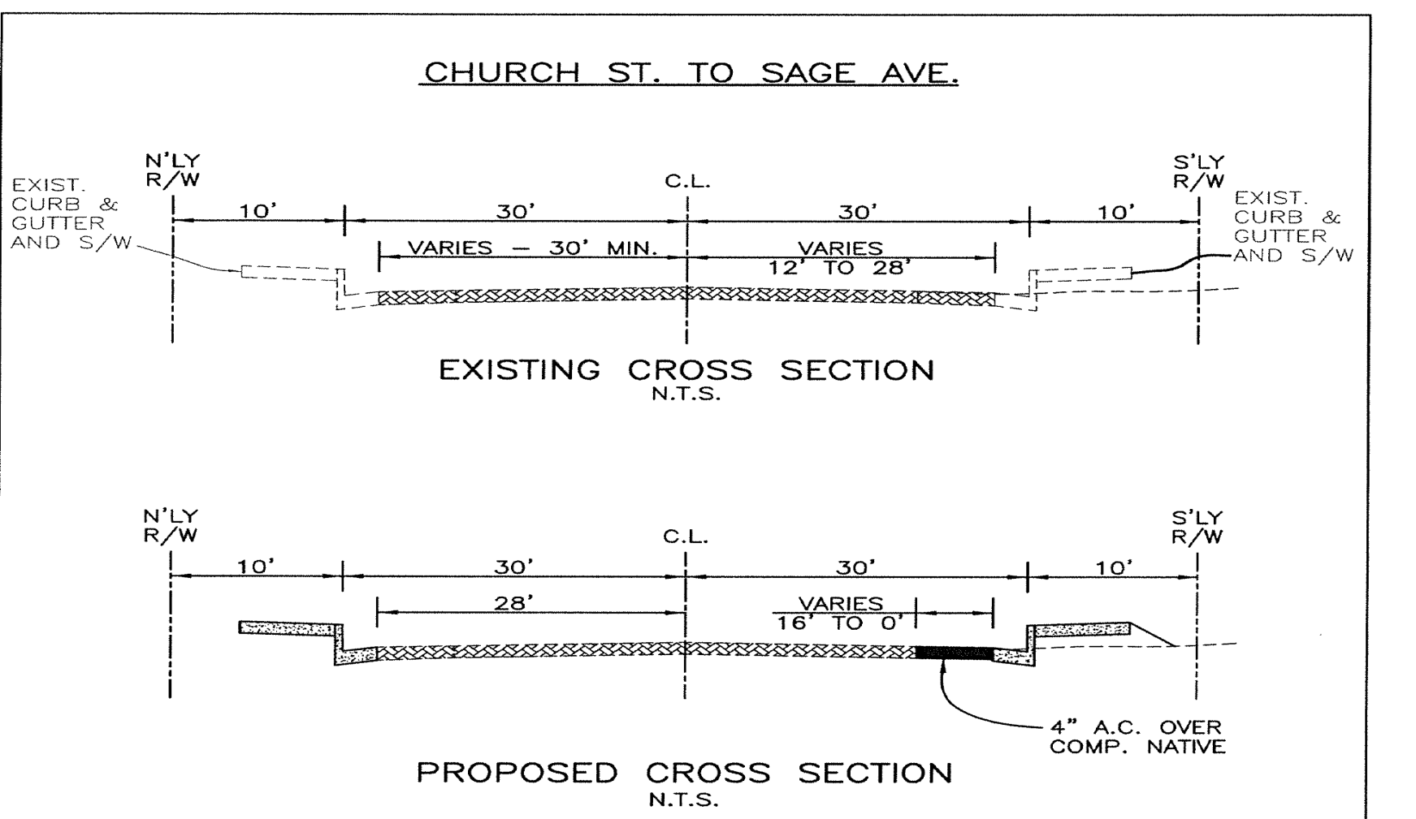
2nd Segment - Onaga Street, between Church Street and approximately Grand Avenue
Onaga Trail Pedestrian Improvement Project
Improved within the existing 80 foot right of way.
Eighty (80’) feet will allow for:
four lanes of traffic,
a painted median with turn pockets,
no on-street parking, and
no shoulder.

Slide 7
Onaga Trail Pedestrian Improvement Project
Project Budget
Project Total Cost (Estimated)= $ 1,663,295.00
Active Transportation Program (ATP) Cycle 3 will fund a total of $776,000
Local match and non-reimbursement eligible costs are funded through a transfer of funds from Fund 524, Measure I.

Slide 8
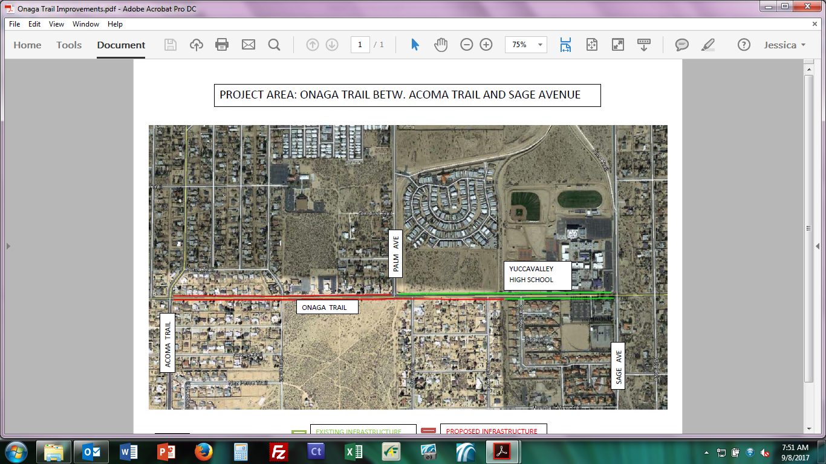
Onaga Trail Pedestrian Improvement Project

Slide 9
Little League Drive Pedestrian Improvement Project
Town Project No. 8970-2020
ATP No. 5466(024)

Slide 10
Project Description
Little League Drive Pedestrian Improvement Project
The project is located on Little League Drive between Palm Avenue and Sage Avenue.
The Project consists of constructing curb and gutter, sidewalk, handicap ramps, driveways, and signing and striping.
Majority of the work will occur on the south side of the roadway.
No widening of the road will occur in locations with existing curb and gutter. However, curb ramps at the intersections may need to be installed/retrofitted.

Slide 11
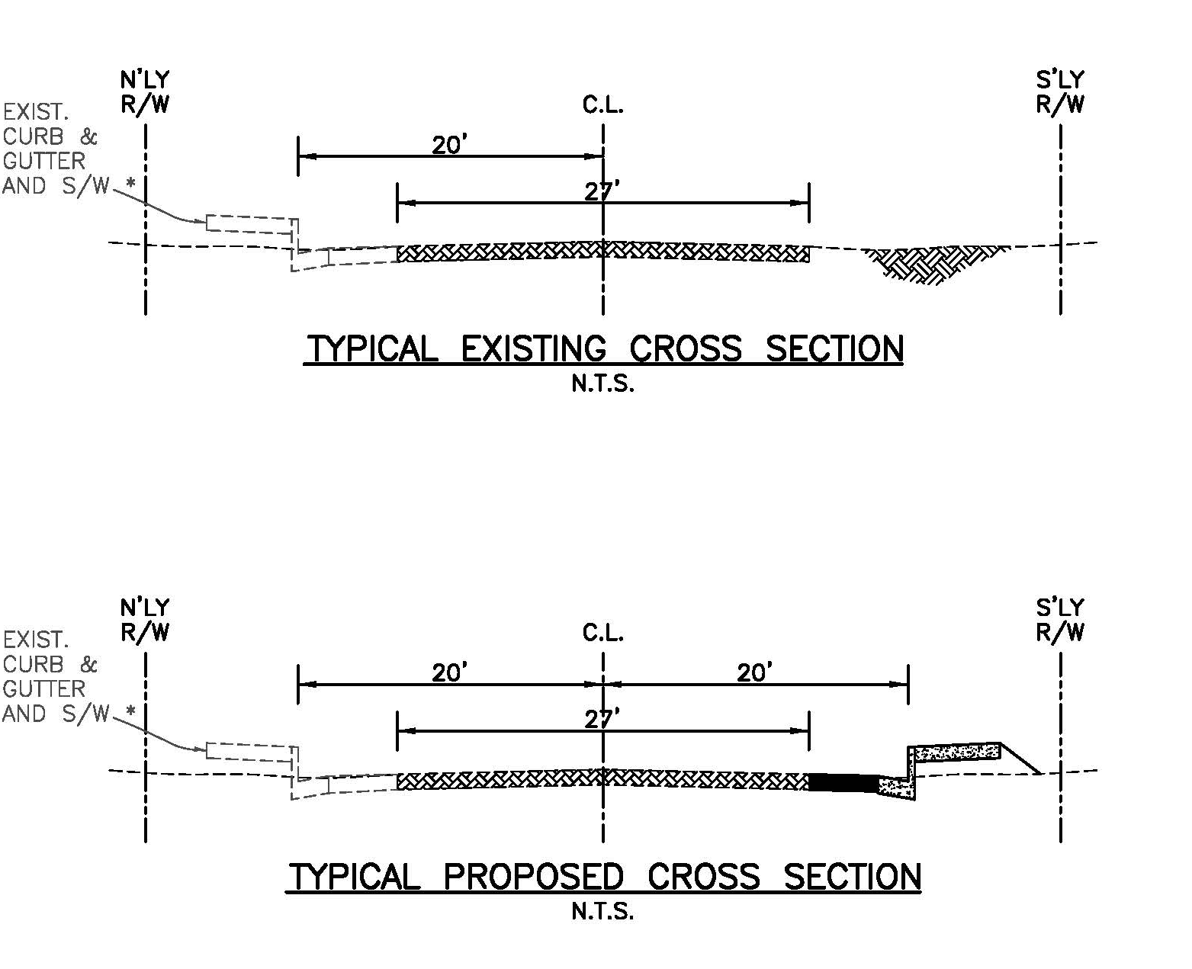
Proposed Improvements
Little League Drive Pedestrian Improvement Project

Slide 12
Little League Drive Pedestrian Improvement Project
Project Budget
Project Total Cost (Estimated)= $ 957,750.00
Active Transportation Program (ATP) Cycle 3 will fund a total of $622,400
Local match and non-reimbursement eligible costs are funded through a transfer of funds from Fund 524, Measure I.

Slide 13
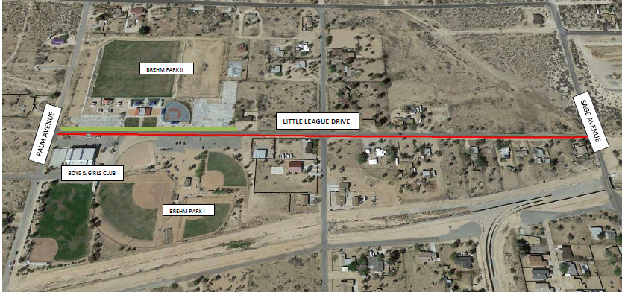
Little League Drive Pedestrian Improvement Project

Slide 14
ATP Projected Construction Schedule
Bid the project: Estimated April/May through June/July 2022
Construction: Estimated August through October 2022
* SR-62 Asphalt Overlay may offset the schedule.
**All subject to Caltrans approvals and Caltrans timelines.

Slide 15
Next Steps
Public Outreach
Joshua Tree Relocation/Removal
Complete Plans and Specifications
Caltrans Authorization to bid
Town Council approval to bid project
Bid the project
Award Contract
Estimated Construction August Through October 2022.

Slide 16
Questions
(Following Public Comment)

